Slide 1
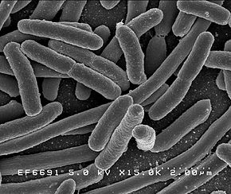
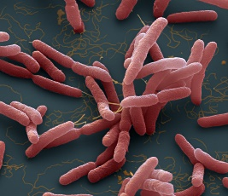
Reflectance Solid Particles
concentration (MES)
Pathogenic bacteria
MES
Escherichia coli
Burkholderia pseudomallei

